Slide 1
Web Project
Hibernate, JPA and Tomcat
In
NetBeans 8.2

Slide 2
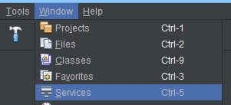
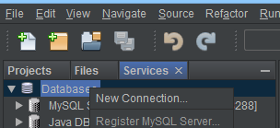
Create Database Connection in
Click on Window in menu bar and select services
Right click on Database and click new connection

Slide 3
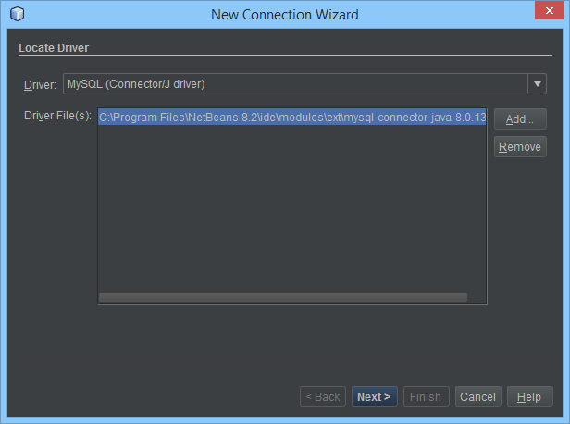
Create Database Connection
Choose MySQL
Check if your connector J version is correct.
The version should be same or higher than MySQL Server.
If not remove driver and click add
Navigate to C:\Program Files (x86)\MySQL\Connector J\
Select the jar file in folder
Click next

Slide 4
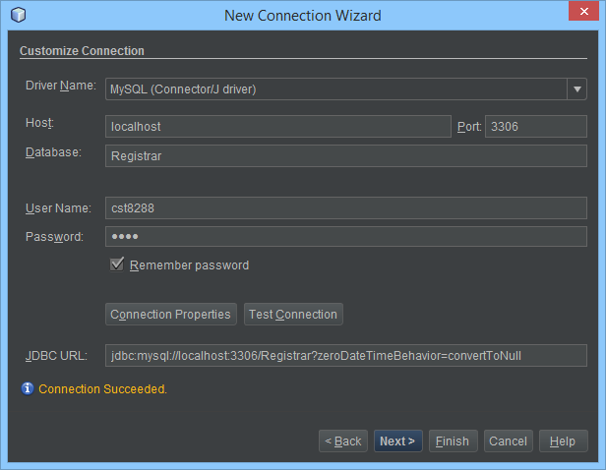
Create Database Connection
Fill in the information, do not modify URL
Port should match the number displayed in workbench connection
Host should be localhost or 127.0.0.1
Database depends on your project
User name and password for this course is cst8288 and 8288. if username does exist add it (next slide).
Test connection
Click next, next again
Name your connection and finish

Slide 5
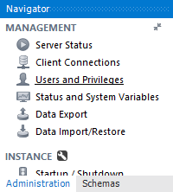
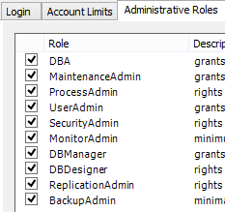
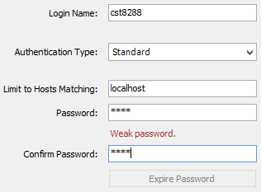
Create new MySQL user in Workbench
Open workbench and click an instance
Click on Users and Privileges
click add account and fill in the info like pic user and pass are cst8288 and 8288
Click apply
Click on Administrative Roles tab
Select DBA, not good practice in real projects
Click apply

Slide 6
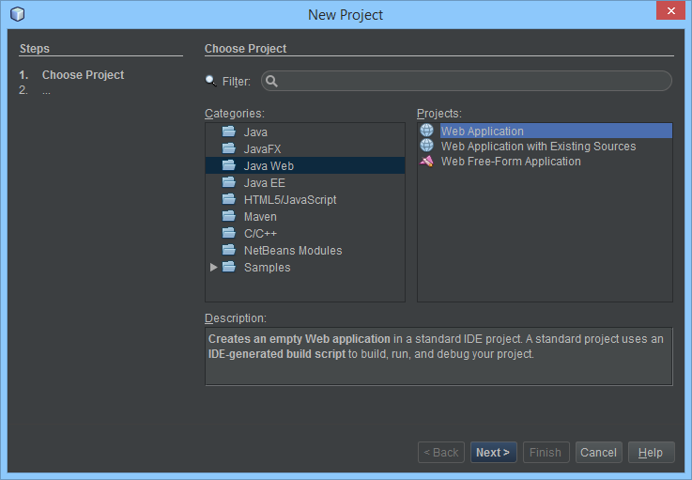
Create a project in NetBeans
Click file and choose new project
Choose java web
Choose web application
Click next

Slide 7
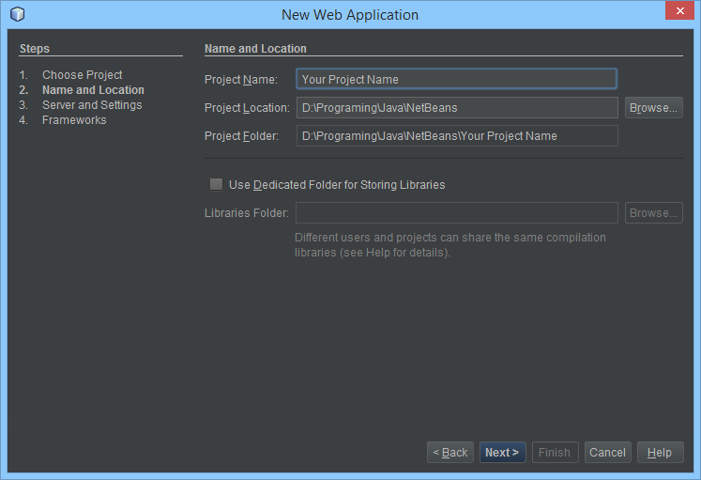
Name and Location
Choose project name
Choose location of project
Click next

Slide 8
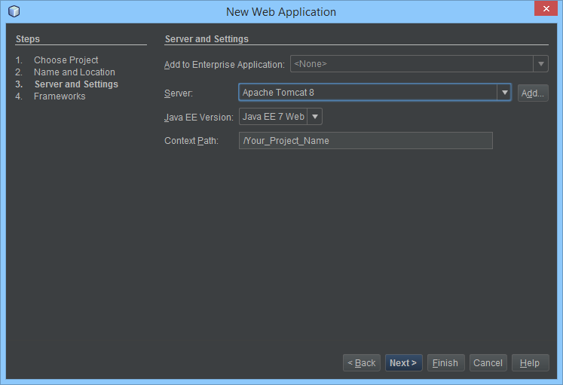
Server and Settings
Choose Tomcat 8
Choose Java EE 7 Web
Context Path is the address to your website: localhost:8080/[context path]

Slide 9
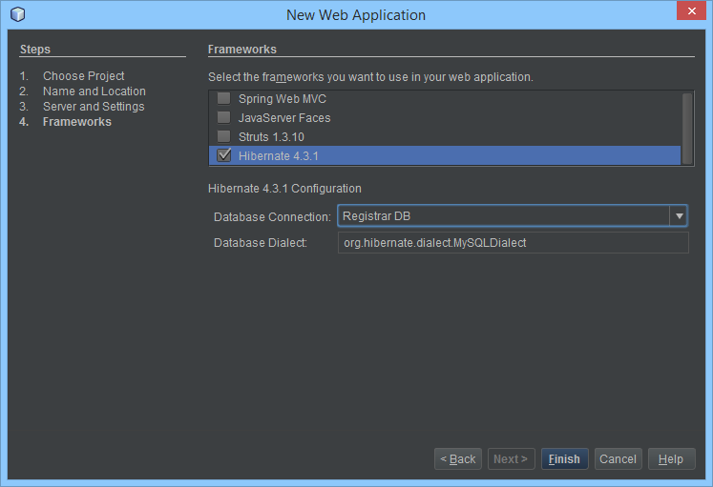
Frameworks, skip for Assignment
Skip for assignment, hibernate 5 will be added manually
Select hibernate library
Select the DB created previously
Dialect is selected by default, but there are many. https://docs.jboss.org/hibernate/orm/4.3/javadocs/org/hibernate/dialect/package-summary.html
Click finish

Slide 10
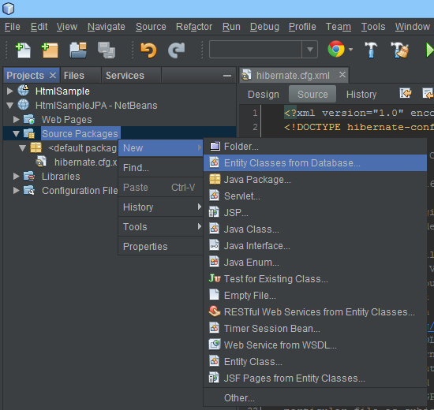
Generating Entities
Right click on source folder go to new and select Entity Classes from Database.
If not visible click other and find it there.

Slide 11
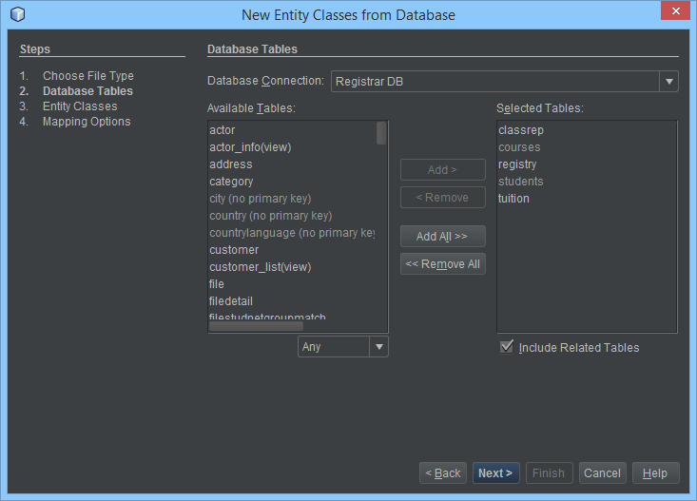
Generating Entities
Select the database connection previously created
Choose the name of tables in the database
Click next

Slide 12
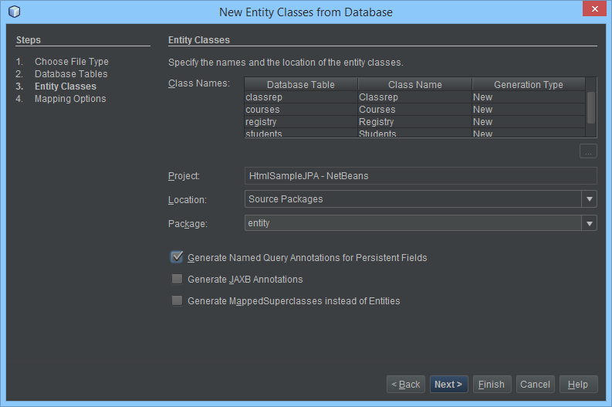
Generating Entities
For package name use entity
Match the check boxes, only first on is clicked
Click next.

Slide 13
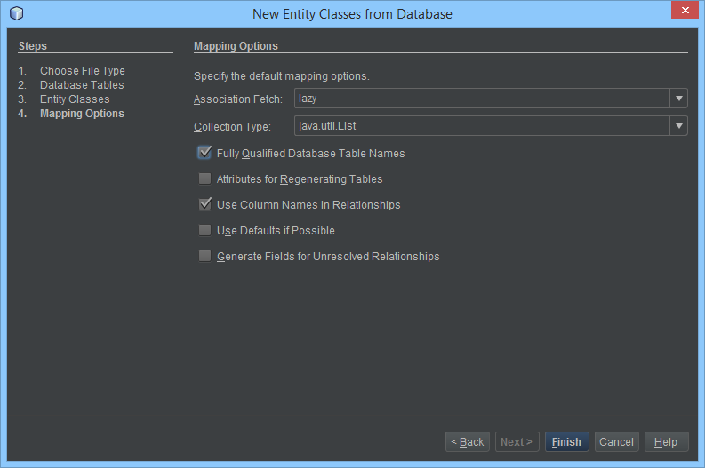
Generating Entities
Choose lazy fetch, meaning only retrieve data for to-one and to-many relationships when called on instead of always.
for collection use list
Match the check boxes, first and third are checked
Click finish

Slide 14
Hibernate
ORM, Object Rational Mapping, technique for converting data between Relational DB and OOP
JPA, Java Persistence API, Java standard for converting data between Relational DB and OOP
JTA, Java Transaction API (JTA) specifies standard Java interfaces between a transaction manager and the parties involved in a distributed transaction system: the resource manager, the application server, and the transactional applications. (defined by oracle)
JPQL - The Java Persistence Query Language is a platform-independent object-oriented query language defined as part of the Java Persistence API specification.
Hibernate, A framework for Object-Relational Persistence and Query service. This framework handles the communication between your program and the DB.

Slide 15
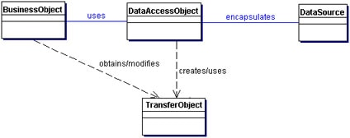
DAO Design Pattern Data Access Object
Layers
Business/logic
Delegates work to Data Access
Error check
Data Access Layer
DB manipulation using DataSource
DataSource can be obtained using JDBC, Tomcat, Hibernate or some container providing a Connection Pool.
Data Transfer Object (DTO)
One class per table in DB
Each instance represents a row of that table

Slide 16
Hibernate and DAO
Logic/Business
Is created by you using functions available in Data Access Layer
Data Access Layer
Is created by you, allowing the manipulation of DB using Hibernate
Data Transfer Object called Entity
Is created by NetBeans IDE as shown in previous slides.

Slide 17
Entity, Data Transfer Object Annotations on Class Definition
@Entity – making this class a DTO for a Table in DB
@Embeddable – used when class to be saved in an Entity like Key Object
@Table – providing to which table this entity connects
It holds name of the table and name of the DB as catalog. scheme if any.
@MappedSuperclass – if there are any common columns between entities, repetition can be rescued. No used by us.
@NamedQueries – it holds multiple @NamedQuery
@NamedQuery – placed inside of @NamedQueries if many otherwise on class definition. It represent one JPQL.
It holds the name of the query and the query in JPQL
Can be used using EntityManger method createNamedQuery. Pass the name.

Slide 18
Entity, Data Transfer Object Annotations on Class Variables Column Mapping
@Id – placed on the primary key
@EmbeddedId – placed in foreign key
@GeneratedValue – how the Auto increment should be created.
@Basic(optional = false) – check on application side if value can be null
@Column(name = "name") – name of the column in table to which this variable connects
@Temporal(TemporalType.DATE) – strip the date to only the date value
@Temporal(TemporalType.TIME) – strip the date to only the time value
@Temporal(TemporalType.TIMESTAMP) – keep date as is
@DateTimeFormat(pattern = "yyyy-MM-dd hh:mm:ss“) – format date

Slide 19
Entity, Data Transfer Object Annotations on Class Variables Relation Mapping
@JoinColumn( name =[“”], referencedColumnName =[“”], insertable = [bool], updatable = [bool]) – refrenced in child table to delcare on which column to join.
name – column name in current table, Foreign key
referencedColumnName – column name in refrenced table, Primary key
insertable – if this entitiy can add this object, true generaly in parrent Entitiy
updatable – if this entitiy can modify this object, true generaly in parrent Entitiy
Relations are @OneToOne, @OneToMany, @ManyToOne and @ManyToMany
cascade = CascadeType.ALL – provide all functionalities such as insert and update, for parent
mappedBy = [“parent“] - parent table owning this variable, for parent
fetch = FetchType.LAZY – get these objects when called on, EAGER from beginning, parent and child
optional = [bool] – are these objects optional, for child. If true must match parent.

Slide 20
Hibernate persistence.xml config file sample without Tomcat
<?xml version="1.0" encoding="UTF-8"?>
<persistence version="2.1“
xmlns="http://xmlns.jcp.org/xml/ns/persistence"
xmlns:xsi=http://www.w3.org/2001/XMLSchema-instance
xsi:schemaLocation="http://xmlns.jcp.org/xml/ns/persistence http://xmlns.jcp.org/xml/ns/persistence/persistence_2_1.xsd">
<persistence-unit name="Registrar" transaction-type="RESOURCE_LOCAL">
<provider>org.hibernate.jpa.HibernatePersistenceProvider</provider>
<class>entity.Courses</class>
<properties>
<property name="javax.persistence.jdbc.url“ value="jdbc:mysql://localhost:3306/Registrar?zeroDateTimeBehavior=convertToNull"/>
<property name="javax.persistence.jdbc.user" value="cst8288"/>
<property name="javax.persistence.jdbc.driver" value="com.mysql.jdbc.Driver"/>
<property name="javax.persistence.jdbc.password" value="8288"/>
<property name="hibernate.dialect" value="org.hibernate.dialect.MySQLDialect"/>
<property name="hibernate.connection.autocommit" value="false"/>
<property name="hibernate.connection.shutdown" value="true"/>
<property name="hibernate.show_sql" value="true"/>
</properties>
</persistence-unit>
</persistence>

Slide 21
Hibernate persistence.xml config file sample with Tomcat
<?xml version="1.0" encoding="UTF-8"?>
<persistence version="2.1“
xmlns="http://xmlns.jcp.org/xml/ns/persistence"
xmlns:xsi=http://www.w3.org/2001/XMLSchema-instance
xsi:schemaLocation="http://xmlns.jcp.org/xml/ns/persistence http://xmlns.jcp.org/xml/ns/persistence/persistence_2_1.xsd">
<persistence-unit name="Registrar" transaction-type="RESOURCE_LOCAL">
<provider>org.hibernate.jpa.HibernatePersistenceProvider</provider>
<non-jta-data-source>java:/comp/env/jdbc/Registrar</non-jta-data-source>
<class>entity.Courses</class>
<properties>
<property name="toplink.logging.level" value="FINEST" />
<property name="hibernate.dialect" value="org.hibernate.dialect.MySQLDialect"/>
<property name="hibernate.connection.autocommit" value="false"/>
<property name="hibernate.connection.shutdown" value="true"/>
<property name="hibernate.show_sql" value="true"/>
</properties>
</persistence-unit>
</persistence>

Slide 22
Hibernate persistence.xml config file JPA configuration
This file must be located in
Java Project: src\META-INF\persistence.xml
Web Project - NetBeans: src\conf\persistence.xml
persistence-unit
name – used with EntityFactoryManager or through dependency injection when using JTA
transaction-type – can be JTA or RESOURCE_LOCAL. JTA if container support JTA.
class – name of all entity classes, each in their own tag
non-jta-data-source – used when using tomcat connection pool with tomcat
properties
Driver, url, pass and username if using Java Project

Slide 23
Hibernate Start using
//get factory with the unit name defined in persistence.xml
EntityManagerFactory factory;
factory = Persistence.createEntityManagerFactory("Registrar");
//create a EntityManger which handles the communication to DB
EntityManager em = factory.createEntityManager();
//start the connection
em.getTransaction().begin();
//create a new course
Courses c1 = new Courses("test103", "oop3");
//add a course
em.persist(c1);
//commit changes to DB
em.getTransaction().commit();
//get a JPQL builder, a sql in OOP manner
CriteriaBuilder criteriaBuilder = em.getCriteriaBuilder();
//create a query condition for given class
CriteriaQuery<Courses> criteriaQuery;
criteriaQuery = criteriaBuilder.createQuery( Courses.class);
//get the root table with entity class that has the data type
Root<Courses> root = criteriaQuery.from( Courses.class);
//select everything from the DB
criteriaQuery.select( root);
//execute query with created criteria and store result in list
List<Courses> all = em.createQuery(criteriaQuery).getResultList();
//select everything where the name column contains oop
criteriaQuery.select( root)
.where(criteriaBuilder.like(root.get("name"),"%oop%"));
//execute query with created criteria and store result in list
List<Courses> filter = em.createQuery(criteriaQuery).getResultList();
//close managet, transaction is now closed
em.close();
//print both lists
all.forEach(c->System.out.println(c));
filter.forEach(c->System.out.println(c));
//hibernate is shutoff
factory.close();

Slide 24
JPA Architecture
EntityManagerFactory – One per DB. creates an manages multiple EntityManager.
EntityManager – An Interface. manages the persistence operations on Entities. It can create Query and CriteriaBuilder.
Entity – Entities are the persistence objects, stores as records in the database. Single threaded and belong to only one Manager.
EntityTransaction – It has one-to-one relationship with EntityManager. For each EntityManager, operations are maintained by EntityTransaction class.
Persistence – This class contain static methods to obtain EntityManagerFactory instance.
Query – This interface is implemented by each JPA vendor to obtain relational objects that meet the criteria.
https://www.tutorialspoint.com/jpa/jpa_architecture.htm

Slide 25
Hibernate Architecture
SessionFactory – it is immutable and thread safe.
Session – it is single threaded. It wraps JDBC and creates transactions. short lived.
Persistence Objects – stores as records in the database. Single threaded and belong to only one Manager.
Transient objects – objects that are not currently managed by session.
Transaction – short lived and single threaded. A manger can have multiple transactions. It is an abstraction to JDBC or JTA.
ConnectionProvider – abstraction between application and DataSource or DriveMenager.
Query – HQA is JPQA implementation. Every JPQA is valid HQA but reverse is not always true. Can create native query as well.
Criteria – Object Oriented Query
https://www.journaldev.com/2882/hibernate-tutorial-for-beginnershttps://www.tutorialspoint.com/hibernate/hibernate_architecture.htm

